Slide 1

Friday, November 9, 2012
Agenda:
TISK; No MM.
Lesson 5-6: Compare side lengths and measures using the Hinge Theorem.
Homework: 5-6 Worksheet
TISK Problems
Simplify: $\frac{90}{\sqrt{21}}$
Simplify: $\sqrt{1352}$

Slide 2
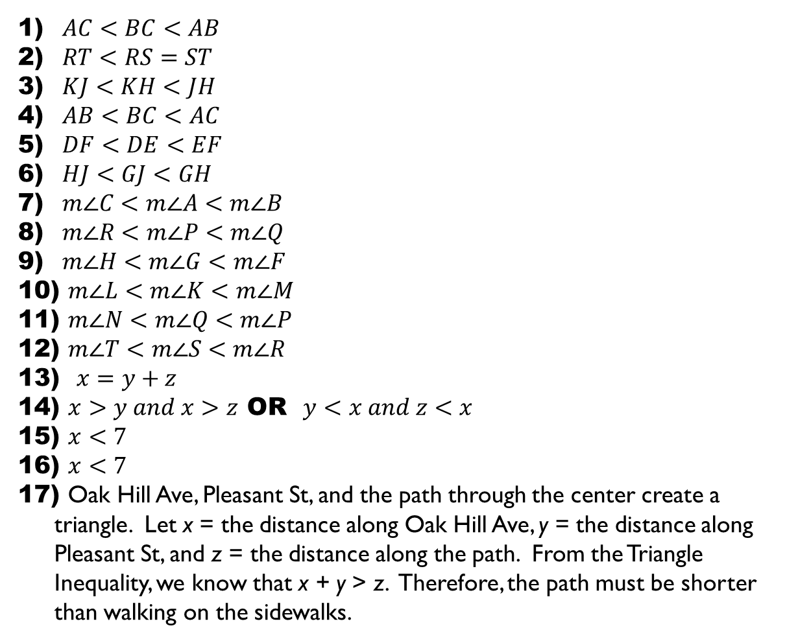
Homework Check
$AC<BC<AB$
$RT<RS=ST$
$KJ<KH<JH$
$AB<BC<AC$
$DF<DE<EF$
$HJ<GJ<GH$
$m∠C<m∠A<m∠B$
$m∠R<m∠P<m∠Q$
$m∠H<m∠G<m∠F$
$m∠L<m∠K<m∠M$
$m∠N<m∠Q<m∠P$
$m∠T<m∠S<m∠R$
$x=y+z$
$x>y and x>z$ OR $y<x and z<x$
$x<7$
$x<7$
Oak Hill Ave, Pleasant St, and the path through the center create a triangle. Let x = the distance along Oak Hill Ave, y = the distance along Pleasant St, and z = the distance along the path. From the Triangle Inequality, we know that x + y > z. Therefore, the path must be shorter than walking on the sidewalks.

Slide 3
§5.6 Indirect Proof & Inequalities in Two Triangles
Indirect Proof
Up until now, all our proofs have been direct.
With Indirect Proof things work a little differently.
Identify the statement you want to prove is true.
Begin by assuming it is false; assume the opposite is true.
Obtain statements that logically follow from your assumption.
If you end at a contradiction, then the original statement must be true.

Slide 4



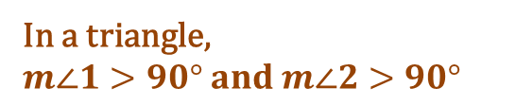





Example 1. Given a triangle. Prove that it has, at most, one obtuse angle.
Statement we are trying to prove:
A triangle has no more than one obtuse angle.
Assume the opposite is true:
A triangle may have more than one obtuse angle.
Statements | Reasons
The last statement is NOT POSSIBLE; angle measures in a triangle cannot be negative.
Therefore, our original assumption must be FALSE.
In a triangle, $m∠1>90° and m∠2>90°$
Assumed
$$m∠1+ m∠2>180°$$
Addition Property
$$m∠1+ m∠2+m∠3=180°$$
$Δ$ Sum Th.
$$m∠1+ m∠2=180°−m∠3$$
Subtraction Property of =
$$180°−m∠3>180°$$
Substitution
$$−m∠3>0°$$
Subtraction Property of =
$$m∠3<0°$$
$÷$ Property of =

Slide 5

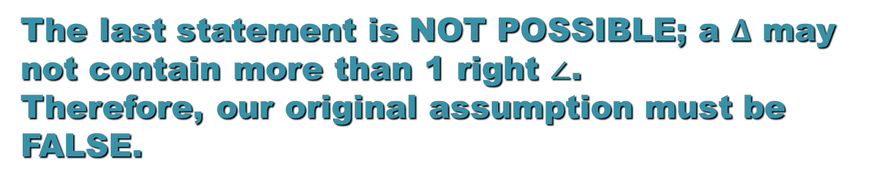

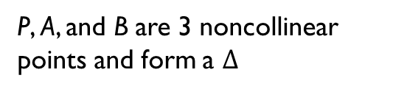
Example 2. Prove that there is at most one line through a point that is perpendicular to a given line.
Statement we are trying to prove:
Given a line and a point not on that line, there is only one line through that point that is perpendicular to the given line.
Assume the opposite is true:
Through a point there is more than one line perpendicular to the given line.
Statements | Reasons
P
$$\overline{PA}⊥\overline{AB} and \overline{PB}⊥\overline{AB}$$
Assumed
P, A, and B are 3 noncollinear points and form a $Δ$
A
B
t
Definition of a Triangle
$$∠PBA and ∠PAB are Rt. ∠s$$
Def. Perpendicular
The last statement is NOT POSSIBLE; a $Δ$ may not contain more than 1 right $∠$. Therefore, our original assumption must be FALSE.

Slide 6

Theorems
Hinge Theorem
If two sides of one triangle are congruent to two sides of another triangle,
and the included angle of the first triangle is larger than the included angle of the second triangle,
then, the third side of the first triangle is longer than the third side of the second triangle.
A
D
$$AC>DF$$
B
C
E
F

Slide 7

Theorems
Converse of the Hinge Theorem
If two sides of one triangle are congruent to two sides of another triangle,
and, the third side of the first triangle is longer than the third side of the second triangle
then, the included angle of the first triangle is larger than the included angle of the second triangle.
A
D
$$m∠B>m∠E$$
8
7
B
C
E
F

Slide 8
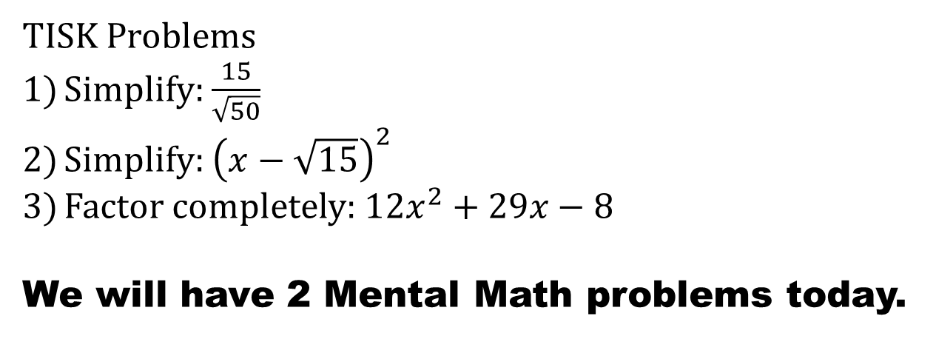
Monday, November 12, 2012
Agenda
TISK & MM
Complete Lesson 5-6
Homework: Finish Worksheet 5-6/Study for Quiz tomorrow
TISK Problems
Simplify: $\frac{15}{\sqrt{50}}$
Simplify: ${\left(x−\sqrt{15}\right)}^{2}$
Factor completely: $12x^{2}+29x−8$
We will have 2 Mental Math problems today.
If you have a signed quiz or test to show me, have it out when I come to your seat.
Notes:
Mental Math
1.) Start with 8 less than the number of feet in a yard. Square it. Subtract twice the number of eggs in a dozen. Take the negative square root. (-1)
2.) Start with 9 more than the number of inches in a pair of inches. Square it. Add the number of inches^2 in a half a dozen inches^2. Subtract half of 14 inches^2. Write your answer in feet^2. (5/6 feet^2)

Slide 9
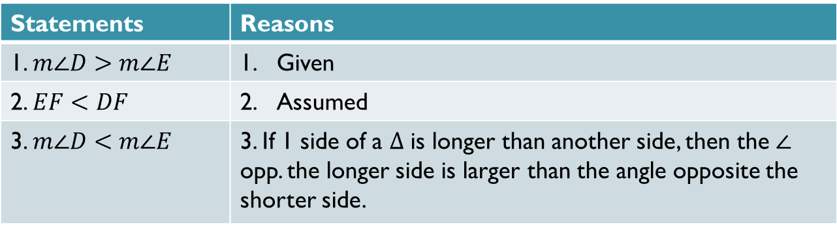
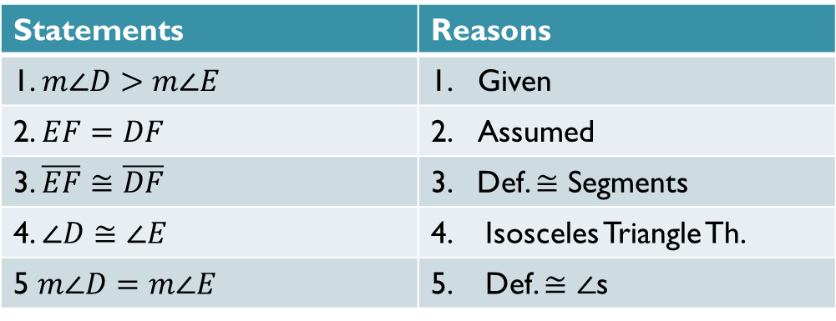
Homework Check
Indirect Proof #16:
Statements | Reasons
1. $m∠D>m∠E$ | Given
2. $EF=DF$ | Assumed
3. $\overline{EF}≅\overline{DF}$ | 3. Def. $≅$ Segments
4. $∠D≅∠E$ | 4. Isosceles Triangle Th.
5 $m∠D=m∠E$ | 5. Def. $≅∠$s
Statement 1 & Statement 5 are contradictions.
Statements | Reasons
1. $m∠D>m∠E$ | Given
2. $EF<DF$ | Assumed
3. $m∠D<m∠E$ | 3. If 1 side of a $Δ$ is longer than another side, then the $∠$ opp. the longer side is larger than the angle opposite the shorter side.
Statement 1 & Statement 3 are contradictions.

Slide 10




Examples. Complete each statement with <, >, or =.
N
27
K
1
26
2
Q
47º
P
46º
L
M
$$m∠1 m∠2$$
$$KL NQ$$
B
D
E
38º
C
37º
A
C
F
$$m∠A m∠C$$
$$DC FE$$

Slide 11



Given: $ΔABC$ Prove: BC > AC
C
B
$$28°$$
$$78°$$
A
What would you have to prove using an indirect proof?
BC = AC is false BC < AC is false.

Slide 12
Quiz Tomorrow
Have your homework for 5-4, 5-5, and 5-6 ready to turn in with your quiz.
Chapter 5 Test is on Wed., Nov. 28th.

